Slide 1

WEIHAI RACE PREVIEW
Elite Analysis · August 27 – 30, 2026
USA Triathlon High Performance

Slide 2
Race Week Schedule
Weihai
August 27 – 30, 2026 • Wave to Wonderland, Huancui District, Weihai, Shandong (CST, UTC+8)
Thu • Aug 27
Fri • Aug 28
Sat • Aug 29
Sat • Aug 29
Arrival & Pool Training
Familiarization & Briefing
ELITE MEN — 09:00
ELITE WOMEN — 12:00
09:00 – 18:00 | Information desk + bike mechanic — Weihaiwei Hotel
08:00 – 10:00 | Pool training — Weihai Swimming Pool (25 m, 4 lanes)
14:00 – 16:00 | Pool training — afternoon session
07:30 / 13:30 | Free LOC shuttle hotel → pool (also 08:30 / 14:30)
09:30 – 10:00 | Elite bike course familiarization
10:00 – 11:00 | Elite swim course familiarization
10:15 – 10:45 | Coaches' feedback on FOP to Technical Delegate
14:30 – 15:00 | Pre-race press conference Brigh Radiance Hotel 12/F
16:00 – 16:30 | ★ Elite Athletes' Briefing — Brigh Radiance Hotel 14/F
16:30 – 17:00 | Team medical meeting + race package distribution
18:00 – 20:00 | Pasta Party — Weihaiwei Hotel 2/F
07:30 – 08:30 | Elite Men athletes' lounge check-in
07:45 – 08:45 | Elite Men transition zone check-in
08:15 – 08:45 | Elite Men swim warm-up
08:30 – 08:45 | Opening ceremony — main venue
08:45 / 08:50 | Elite Men line-up (lounge) / introduction (swim exit)
09:00 | ★ ELITE MEN START
10:55 | Elite Men awards ceremony
10:30 – 11:30 | Elite Women athletes' lounge check-in
11:00 – 11:45 | Elite Women transition zone check-in
11:15 – 11:45 | Elite Women swim warm-up
11:15 – 11:45 | Elite coaches run course measurement
11:45 / 11:50 | Elite Women line-up / introduction
12:00 | ★ ELITE WOMEN START
14:10 | Elite Women awards ceremony
Times Wave to Wonderland, Huancui District, Weihai, Shandong (CST, UTC+8). Schedule confirmed from World Triathlon race-info page / athlete guide; subject to organiser updates.

Slide 3
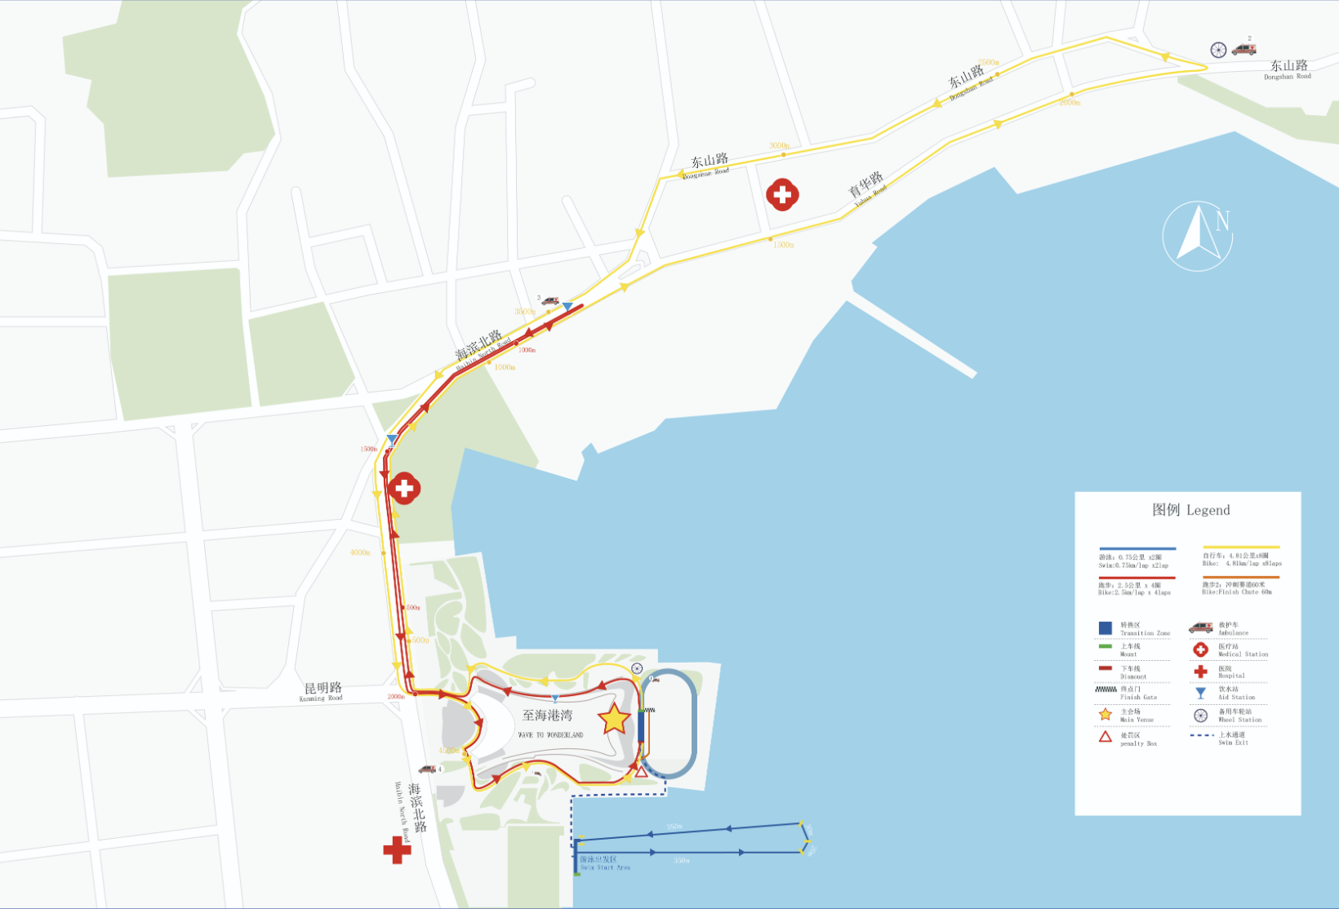
Key Course Differentiators
Weihai
WEIHAI
COURSE AT A GLANCE
Swim:
1.5 km – 2 laps × 750 m
WTCS Weihai returns to the Wave to Wonderland venue on China's Shandong peninsula for the 2026 Championship Series. Weihai is one of the most established venues on the calendar, hosting elite racing since 2011 and stepping up from World Cup to WTCS in 2024. The format is an Olympic distance with a slightly short bike. Two things separate this edition from recent history. First, the date moves to 29 August, roughly four weeks earlier than the 2024 and 2025 editions, which means this could be much warmer than the past two editions. Second, the men start at 09:00 and the women at 12:00, into peak midday sun. WT's recorded race-day temperature has come in about 4 °C higher for the women in every measured edition.
Bike:
38.5 km – 8 laps × 4.81 km
Run:
10 km – 4 laps × 2.5 km
Format:
Standard Distance (WTCS)
Bike Laps:
8
Run Laps:
4
QUICK LINKS
Current Race Info:
Race Info | 2026 WTCS Weihai
COURSE FEATURES
• OLYMPIC distance with a slightly short bike leg. Almost entirely flat bike and run course
• Non-wetsuit is almost certain. Water has measured 24-26 °C and been ruled wetsuit-forbidden in all four editions. Waterfront start.
• Men’s and women’s have played out differently here. On the men’s side breakaways have stuck, while women’s racing have come together.
• Heat is asymmetric: men 09:00, women 12:00 into peak sun with weather projections nearly 4°C warmer than the Men’s.

Slide 4

Swim Course Profile
Weihai
1.5 km • 2 × 750 m
Open sea bay; salt water, seafront start
Distance
Layout
Start
1.5 km
Yellow Sea
Waterfront
Water Temp
Wetsuit
Lap Count
27.6 °C (7-yr avg)
Forbidden (> 22 °C)
2
Source: 2026 WTCS Weihai Athletes' Guide (updated 22 July 2026)
Tactical Notes
• Standard-distance swim: 2 × 750 m counter-clockwise laps in the Yellow Sea
• Salt water and open bay. Potential for moderate swell and chop
• Water has run 24–26 °C in every measured edition, so this is a warm, non-wetsuit swim
• Swim familiarization is Friday 28 Aug 10:00–11:00 only; swimming the race course at any other time is prohibited

Slide 5
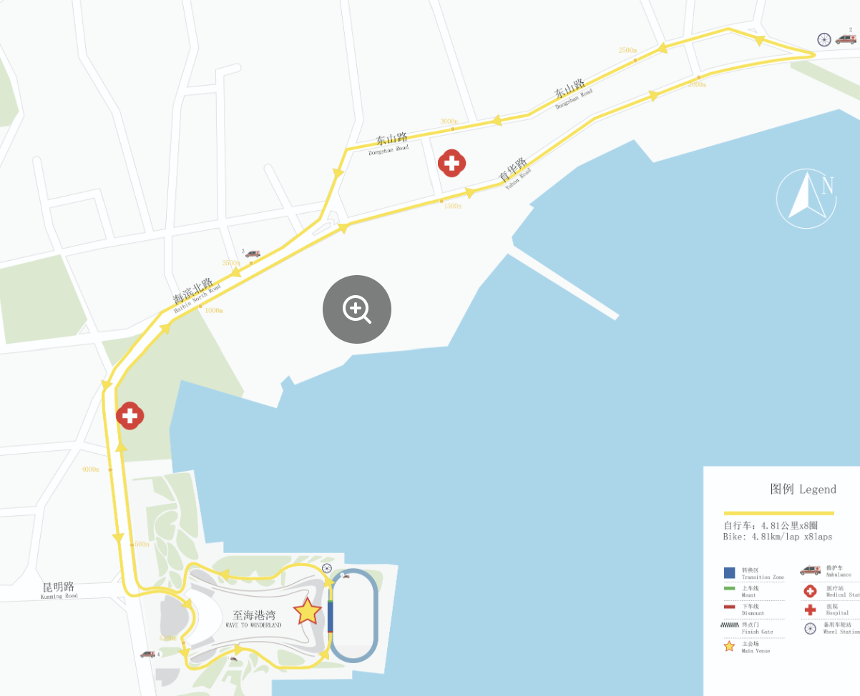
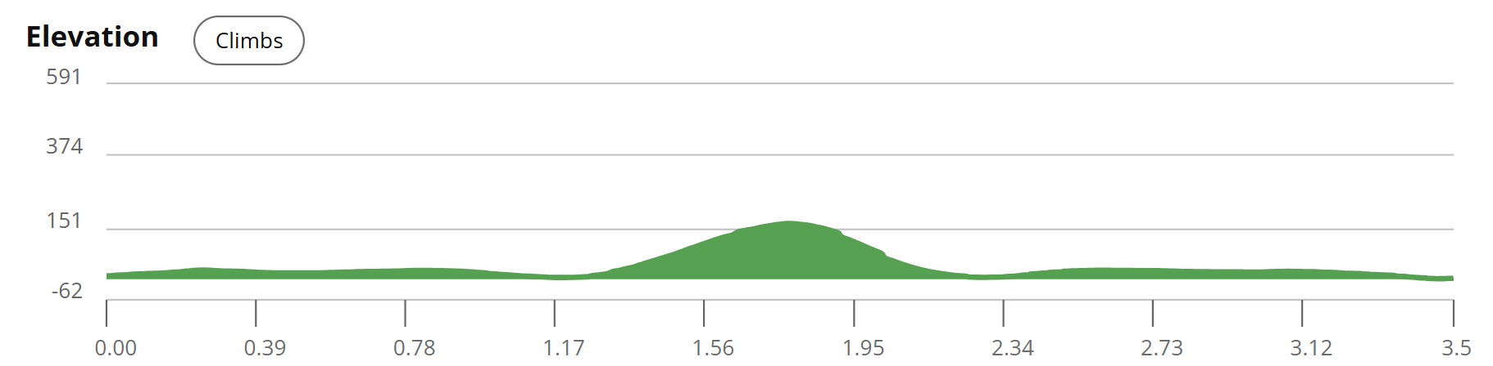
Bike Course Profile
Weihai
38.5 km • 8 × 4.81 km loops
Closed city roads; Haibin North Rd, Yuhua Rd turnaround, Dongshan Rd
Elevation / Lap
Total Climb
Avg Grade
210 ft. / lap
1680 ft.
5.8% on the climb
Max Climb Grade
Wind
Loops
~8%
Coastal average ~18 km/h, prevailing SE
8 × 4.81 km
Tactical Implications
• 8 × 4.8 km laps = 38.5 km; Route: transition at the Wave to Wonderland running track, north on Haibin North Rd to the Yuhua Rd turnaround, left onto Dongshan Rd, back down Haibin North Rd
Source: 2026 WTCS Weihai Athletes' Guide (updated 22 July 2026) + WT race info
• Lap-heavy, turnaround-heavy design punishes riders who sit at the back of the pack
• Coastal seafront exposure on Haibin North Rd — the guide's prevailing SE wind will be a cross/head component on one leg of every lap
Flat course — published profile shows no significant climbs. No elevation chart synthesized; if a race GPS FIT becomes available, real contours will replace this block.

Slide 6
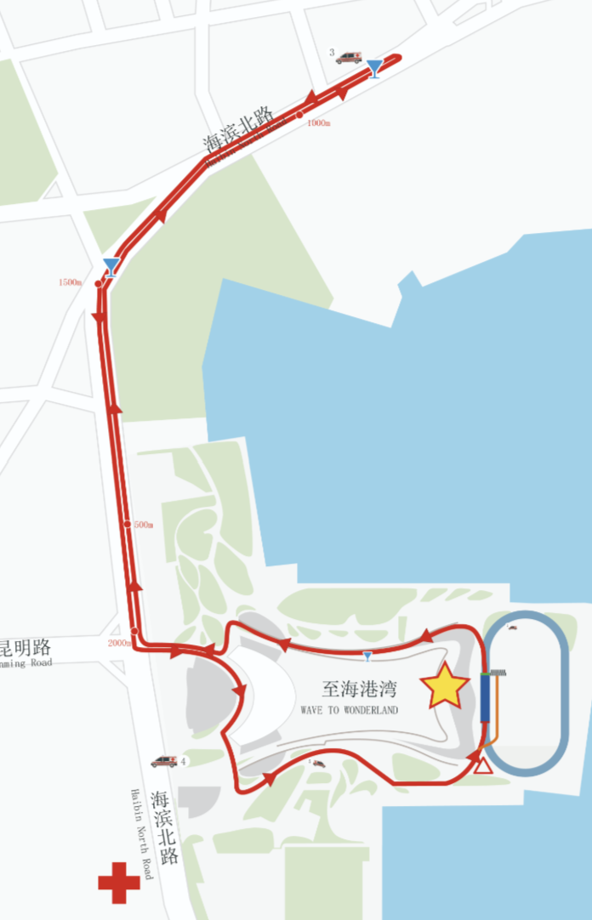
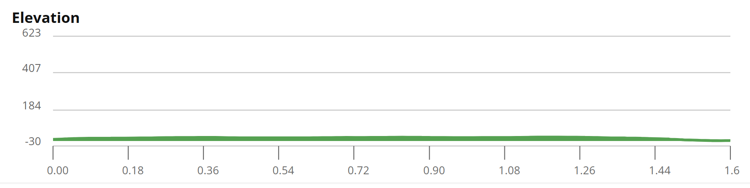
Run Course Profile
Weihai
10.0 km • 4 × 2.5 km
Closed seafront road (Haibin North Rd) out-and-back
Distance
Lap Structure
Total Climb
10.0 km
4 × 2.5 km
~64 ft
Avg Grade
Max ▲ / ▼
Heat Risk
0%
~1-2%
MODERATE / HIGHER for women
Tactical Notes
• 4 × 2.5 km laps = 10 km: north up Haibin North Rd to a turnaround, u-turn, return to transition, then into the finish chute at the main venue
• HEAT IS NOT SYMMETRIC: WT's recorded race-day air temp has been 3.9–4.7 °C higher for the women in each of the last three editions (2023, 2024, 2025)
• 2026 moves to 29 August, ~4 weeks earlier than the 2024/2025 editions. The closest race time from is 2023 (26 Aug), the hottest on record here: 27.2 °C men / 31.9 °C women
Source: 2026 WTCS Weihai Athletes' Guide (updated 22 July 2026)

Slide 7
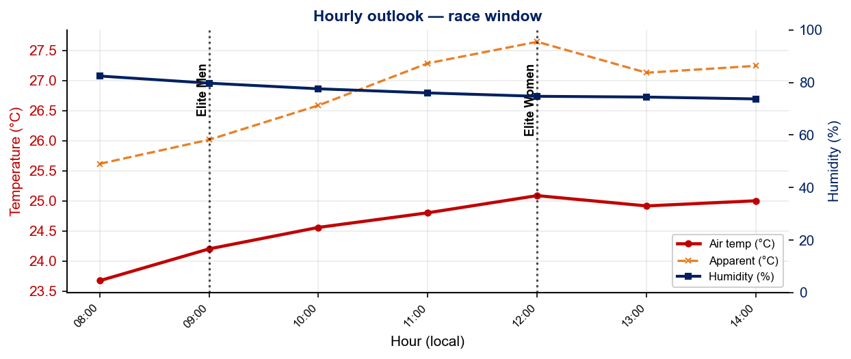
Race-Day Weather Outlook
Weihai
2026-08-29 • Historical climatology — same calendar day, 7-year mean
Elite Men — 09:00
Temperature
Apparent / Heat
Humidity
24.5 °C
26.6 °C
78%
Wind
UV peak
Heat Stress
14.9 km/h
—
MODERATE
Elite Women — 12:00
Temperature
Apparent / Heat
Humidity
25.0 °C
27.3 °C
74%
Wind
UV peak
Heat Stress
14.4 km/h
—
MODERATE
Hydration & Cooling Cues
• Standard heat protocol. Pre-cool 10 min with ice or ice vests, make use of sponges/ice at aid stations
• Notable wind (15 km/h) potential from the sea breeze. Drafting can be a key component on exposed coastal bike sections;
Data source: Open-Meteo. Forecast will replace climatology once race day is within 16 days. Historical Race Conditions slide shows what actually happened in prior years.

Slide 8
Travel & Arrival Load
Denver, CO → Weihai race week
Core travel read
The longest trip on the 2026 calendar. Denver → Weihai (WEH) needs two or three legs, typically DEN to a US west-coast gateway, then a trans-Pacific into Beijing/Shanghai/Seoul, then a final Chinese domestic flight or the high-speed rail into Weihai. Budget 24–30 h door to door. CST is UTC+8, 14 hours ahead of Denver (MDT),
Primary route
Time zones
Airport Transfer
Rail alternative
Hotel → Venue
DEN → WEH
+14h
WEH → Hotel
Weihai North HSR
0.8 km
2–3 legs via PEK/PVG/ICN
CST UTC+8 vs Denver MDT
46.2 km / ~50 min
8.4 km / ~18 min to hotel
Walking distance
Host Hotel / Accommodation
China-Specific Practical Notes
• Official hotel: Weihaiwei Hotel, No. 82 Haigang Road, Huancui District. ~0.8 km from the main venue,
• POWER BANKS: mainland domestic flights require the 3C/CCC logo. Non-certified banks are routinely confiscated, including at transit security on a domestic connection.
• Briefing and press conference are at the Brigh Radiance Hotel, ~500 m from the official hotel (briefing Fri 28 Aug 16:00–16:30).
• Payment is QR-dominant (WeChat Pay / Alipay); link an international card before travelling and carry ¥500–1,000 cash for edge cases. Also Google Store is typically shadowbanned, so Android uses must download apps beforehand.
• Amenities: free Wi-Fi, fitness centre, free laundry on the 2nd floor, two bottles of water and fruit per room daily, free room-service delivery.
• Electricity 220 V / 50 Hz. Plug types A (US flat), I (AU) and some C (EU) — most hotels have universal sockets, but bring an adapter.
• Athlete/coach set meals 198–498 CNY per person in Liugong Island Hall (2/F). Pasta Party Fri 28 Aug 18:00–20:00, vegetarian and halal available.
• Pool training available 27–28 Aug at Weihai Swimming Pool (25 m, 4 lanes reserved, free) with a free LOC shuttle from the hotel at 07:30/08:30/13:30/14:30.

Slide 9
Who to Watch — Weihai Race Week
ELITE MEN
ELITE WOMEN
Top 10 Ranked on Startlist
Top 10 Ranked on Startlist
Rank | Athlete | Points
1 | Matthew Hauser | 7,297
6 | David Cantero Del Campo | 5,092
7 | Luke Willian | 4,734
13 | Max Studer | 3,488
14 | Tyler Mislawchuk | 3,342
17 | Alberto Gonzalez Garcia | 3,188
19 | Callum McClusky | 2,983
20 | John Reed | 2,898
35 | João Nuno Batista | 2,581
38 | Roberto Sanchez Mantecon | 2,530
Rank | Athlete | Points
1 | Beth Potter | 7,276
2 | Lisa Tertsch | 7,270
6 | Cassandre Beaugrand | 5,391
10 | Diana Isakova | 4,750
11 | Tanja Neubert | 4,583
16 | Gina Sereno | 3,205
17 | Roksana Slupek | 3,201
18 | Valentina Riasova | 3,120
19 | Tilly Anema | 2,984
23 | Sara Guerrero Manso | 2,876
Returning Podium Athletes on Startlist
Returning Podium Athletes on Startlist
1. Max Studer (01:40:03)
1. Beth Potter (01:51:58)
3. John Reed (01:40:35)
2. Lisa Tertsch (01:52:15)
3. Tanja Neubert (01:52:19)
Rankings = current World Triathlon rankings snapshot; startlist intersect uses program_entries when available.

Slide 10
Top Swim Threats
Weihai
Ranked by Lead Pack % (within 15 s of swim leader — robust to course speed) • EWMA swim split (span-5) shown per distance; Sprint = this race • WTCS / World Cup / Continental, last 4 yrs
ELITE MEN
ELITE WOMEN
# | Athlete | Lead % | EWMA Spr ▸ | EWMA Std | Spr/Std
1 | Matthew Hauser | 94% | 8:28 | 17:09 | 7/11
2 | Chase McQueen | 85% | 9:04 | 17:47 | 9/11
3 | Blake Bullard | 80% | 9:51 | — | 10/0
4 | Alberto Gonzalez Garcia | 79% | 9:03 | 18:08 | 16/8
5 | Kenji Nener | 74% | 8:53 | 18:15 | 10/13
6 | Zalán Hóbor | 73% | 8:54 | 17:08 | 9/2
7 | João Nuno Batista | 70% | 8:53 | 18:05 | 6/4
8 | Takumi Hojo | 65% | 8:57 | 18:21 | 17/14
9 | Martin Demuth | 64% | 9:07 | 17:15 | 16/12
10 | Maciej Bruzdziak | 64% | 8:55 | 18:00 | 7/15
11 | Gergely Kiss | 62% | 8:53 | 17:57 | 10/6
12 | Nicola Azzano | 62% | 8:57 | 18:01 | 21/13
13 | Darr Smith | 58% | 9:05 | 18:07 | 17/14
14 | Alois Knabl | 57% | 8:59 | 17:10 | 8/13
# | Athlete | Lead % | EWMA Spr ▸ | EWMA Std | Spr/Std
1 | Tilly Anema | 100% | 9:22 | 19:20 | 5/5
2 | Vittoria Lopes | 100% | 10:11 | 19:15 | 7/8
3 | Cassandre Beaugrand | 87% | 9:50 | 19:42 | 5/10
4 | Desirae Ridenour | 81% | 10:11 | 19:31 | 20/1
5 | Yuan Yuan | 80% | 9:56 | 20:17 | 2/8
6 | Kirsten Kasper | 62% | 10:06 | 20:03 | 6/10
7 | Beth Potter | 61% | 9:56 | 19:08 | 5/13
8 | Rosa Elena Martinez Melchior | 61% | 10:08 | 20:33 | 17/11
9 | Kanae Takenaka | 56% | 10:04 | 19:50 | 10/6
10 | Selina Klamt | 52% | 9:44 | 19:54 | 10/11
11 | Lisa Tertsch | 52% | 9:41 | 19:04 | 10/19
12 | Roksana Slupek | 48% | 9:59 | 19:39 | 7/14
13 | Sara Guerrero Manso | 44% | 10:09 | 19:39 | 19/8
14 | Manami Hayashi | 42% | 9:56 | 20:06 | 17/7

Slide 11
USA World Rankings Snapshot
Weihai
As of 2026-08-24 • World Triathlon Rankings • Heading into Weihai • Race tier: WTCS
Max Points Available at this Race
Win
Podium
Top 5
Top 10
Top 15
Top 20
1,000 pts
855 pts
732 pts
495 pts
335 pts
227 pts
ELITE MEN
ELITE WOMEN
Rank | Athlete | Points | Curr | Prev
20 | John Reed | 2,898 | 6 | 6
22 | Reese Vannerson | 2,818 | 6 | 6
27 | Morgan Pearson | 2,680 | 5 | 4
42 | Braxton Legg | 2,442 | 6 | 6
50 | Sullivan Middaugh | 2,281 | 6 | 6
53 | Seth Rider | 2,243 | 6 | 4
67 | Keller Norland | 1,988 | 6 | 6
80 | Blake Bullard | 1,732 | 6 | 6
84 | Chase McQueen | 1,708 | 6 | 6
108 | Porter Middaugh | 1,513 | 6 | 6
113 | Darr Smith | 1,452 | 6 | 6
116 | Zach Leachman | 1,433 | 6 | —
137 | Carter Stuhlmacher | 1,274 | 6 | 3
284 | Cole Jamieson | 600 | 4 | 2
350 | Foster Wilfong | 448 | 4 | —
Rank | Athlete | Points | Curr | Prev
9 | Taylor Spivey | 5,091 | 6 | 3
16 | Gina Sereno | 3,205 | 6 | 6
26 | Danielle Orie | 2,717 | 6 | 6
27 | Gwen Jorgensen | 2,700 | 6 | 6
42 | Erika Ackerlund | 2,341 | 6 | 6
46 | Kelly Wetteland | 2,109 | 6 | 3
51 | Taylor Knibb | 2,047 | 4 | —
60 | Naomi Ruff | 1,968 | 6 | 6
90 | Kirsten Kasper | 1,551 | 5 | 2
94 | Eleanor Beveridge | 1,479 | 6 | 5
101 | Joy Gill | 1,421 | 6 | 6
113 | Rachel Werking | 1,328 | 6 | 3
131 | Michelle Magnani | 1,242 | 6 | 6
144 | Faith Duncan | 1,156 | 6 | —
163 | Katie McCune | 1,042 | 6 | 1

Slide 12
Olympic Qualification Pace
Weihai
Paris 2024 OQR cutoff (30th): 3,626.69 pts ÷ 12-event cap = 302 pts / event on pace
An athlete who averages ~302 pts per event across their best 12 events is on pace to clear the LA 2028 qualifying threshold.
FINISH POSITION AT EACH TIER THAT HITS 302-PT PACE
Tier | Win pts | Last on-pace pos | First off-pace pos (pts) | Verdict
World Championship Series | 1000 | #16 | #17 (287 pts) | Top 16
World Cup | 500 | #7 | #8 (290 pts) | Top 7
USA MEN
USA WOMEN
Rk | Athlete | Total | Races | On | Off | Pace | Proj @12
12 | Sullivan Middaugh | 1,573 | 5 | 2 | 3 | 314 | 3,776
16 | Reese Vannerson | 1,479 | 4 | 3 | 1 | 369 | 4,439
19 | Seth Rider | 1,341 | 4 | 3 | 1 | 335 | 4,023
20 | Braxton Legg | 1,274 | 4 | 2 | 2 | 318 | 3,823
24 | Keller Norland | 1,087 | 3 | 2 | 1 | 362 | 4,349
36 | Morgan Pearson | 904 | 2 | 1 | 1 | 452 | 5,425
41 | Chase McQueen | 816 | 4 | 1 | 3 | 204 | 2,450
60 | John Reed | 599 | 2 | 1 | 1 | 299 | 3,598
66 | Blake Bullard | 513 | 3 | 0 | 3 | 171 | 2,055
68 | Porter Middaugh | 481 | 3 | 1 | 2 | 160 | 1,926
107 | Zach Leachman | 212 | 1 | 0 | 1 | 212 | 2,545
Rk | Athlete | Total | Races | On | Off | Pace | Proj @12
9 | Taylor Knibb | 2,047 | 4 | 4 | 0 | 511 | 6,142
13 | Taylor Spivey | 1,795 | 3 | 3 | 0 | 598 | 7,180
15 | Danielle Orie | 1,646 | 5 | 3 | 2 | 329 | 3,951
16 | Gina Sereno | 1,450 | 4 | 2 | 2 | 362 | 4,351
28 | Kelly Wetteland | 925 | 2 | 2 | 0 | 462 | 5,550
32 | Naomi Ruff | 882 | 3 | 1 | 2 | 294 | 3,530
45 | Erika Ackerlund | 720 | 3 | 1 | 2 | 240 | 2,882
56 | Eleanor Beveridge | 567 | 3 | 0 | 3 | 189 | 2,269
58 | Gwen Jorgensen | 556 | 2 | 1 | 1 | 278 | 3,337
91 | Rachel Werking | 271 | 2 | 0 | 2 | 135 | 1,629
110 | Joy Gill | 200 | 2 | 0 | 2 | 100 | 1,203
On = events scoring ≥ pace. Off = events < pace. Pace = total breakdown pts ÷ events raced. Proj @12 = current total + (avg pts × remaining events to cap); green if ≥ Paris cutoff. Cutoff estimate: Paris 2024 = 3,627 pts / 12 events = 302 pts/event. Tier positions use a geometric 0.925 points model. Source: World Triathlon rankings database.

Slide 13
ELITE MEN

Slide 14
Race Overview — Elite Men
Weihai
RACE HISTORY AT WEIHAI
3 KEYS TO SUCCESS
The Elite Men race at Weihai has been held 5 times in this analysis window (2018–2025). The event is staged as part of the World Cup / World Championship Series calendar. Race dynamics here can depend largely on race day temperature with the past two years falling on cooler days that led to faster racing across each discipline. With the race falling earlier in the year, except for a greater likelihood of a larger group coming off the bike together. Managing heat pre and during the race will also be critical.
1
Warm temperature here has historically kept the field relatively close together. The delta from the average to the fastest swim split has only been ~30 seconds in the past three editions of the race.
2
Bike dynamics here can depend strongly on the weather. In 2023 when the race was held in August in warmer temperatures the chase pack came together. In 2024 and 2025 when the race was in September with cooler temperatures, the front was able to push the pace and breakaway from the group.
3
Winning run times here tend to be on the fast end with the past two years the winning time right at the 30-minute barrier. However, again in 2023 with the warmer temperature, both the fastest and average run times were substantially slower.

Slide 15
Results Summary — Elite Men
Weihai
Year | Date | Category | Field | DNF/LAP/DNS | Winner | Winner Time | Air Temp | Water Temp | Swim km | Bike km | Run km
2018 | Sep 22 | World Cup | 57 | 13 | Iden | 1:53:11 | 23.5°* | — | — | — | —
2019 | Sep 21 | World Cup | 48 | 9 | Silva | 1:54:47 | 23.3°* | — | — | — | —
2023 | Aug 26 | World Cup * | 45 | 11 | Valencia | 1:46:35 | 27.2 | 25.8 | 1.50 | 38.4 | 10.0
2024 | Sep 27 | World Championship Series * | 42 | 7 | Yee | 1:48:21 | 24.1 | 24.4 | 1.50 | 40.0 | 10.0
2025 | Sep 26 | World Championship Series * | 37 | 2 | Studer | 1:40:03 | 24.9 | 24.2 | 1.50 | 38.0 | 10.0
* Course distance changed vs. prior year

Slide 16
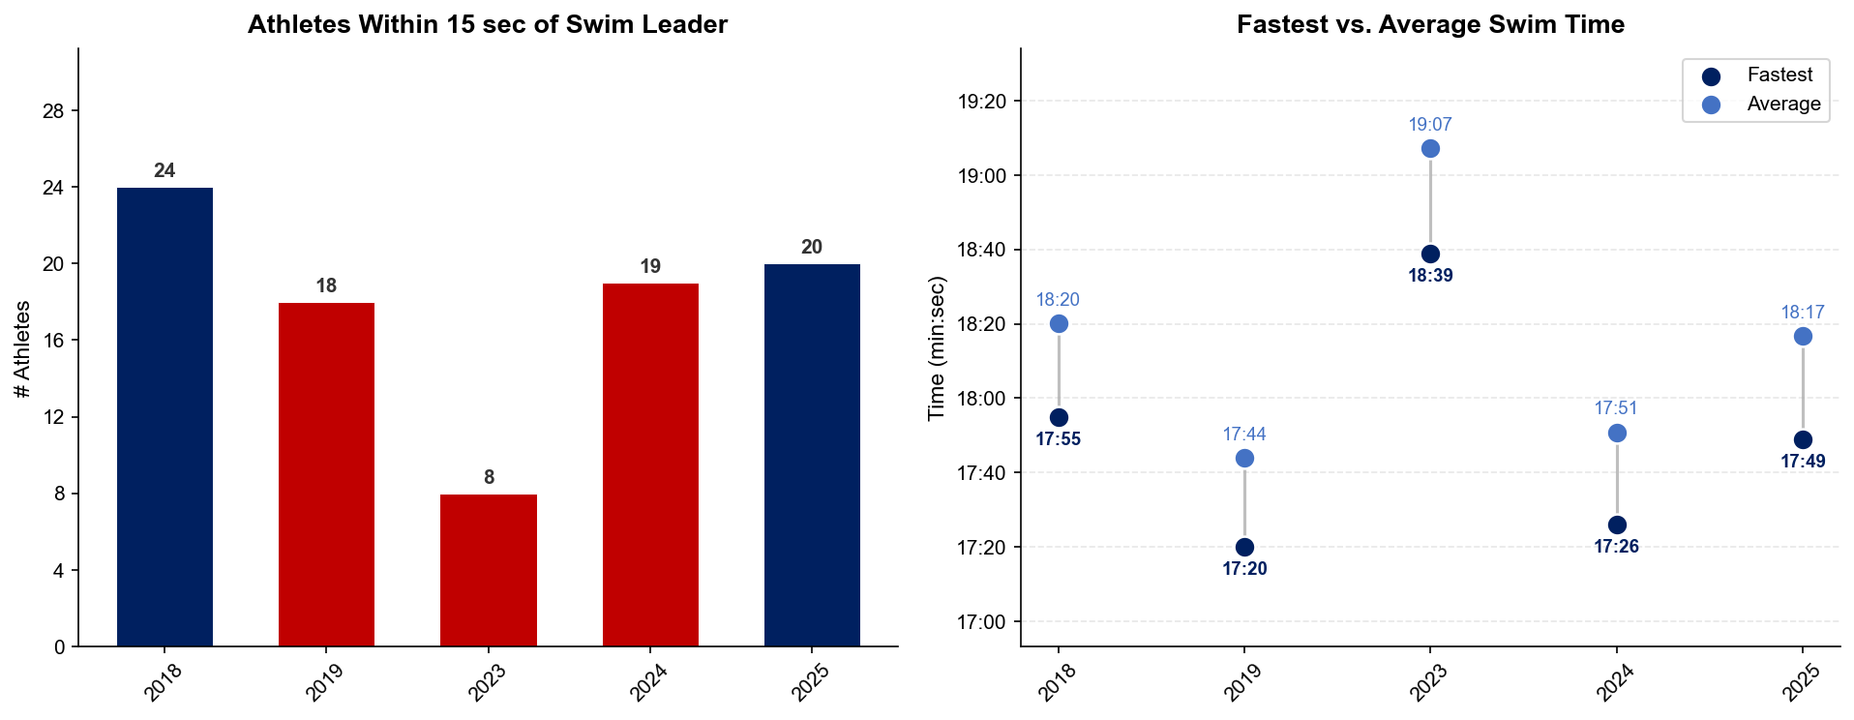
Swim Exit Dynamics — Elite Men
Weihai

Slide 17
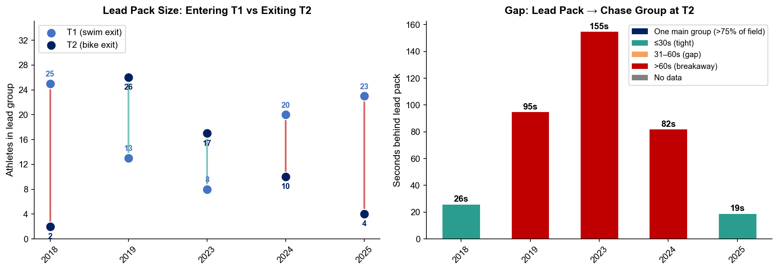
Bike Pack Evolution — Elite Men
Weihai
Lead pack = athletes within 15 sec of leader. T1 = lead group entering the bike; T2 = lead group exiting the bike.
Year | Lead Size @ T1 | Lead Size @ T2 | Change | Chase Group @ T2 | Chase Gap*
2018 | 25 | 2 | -23 | 24 | 26s
2019 | 13 | 26 | +13 | 1 | 95s
2023 | 8 | 17 | +9 | 5 | 155s
2024 | 20 | 10 | -10 | 15 | 82s
2025 | 23 | 4 | -19 | 14 | 19s
Lead pack = athletes within 15 sec of leader. Chase group = athletes within 15 sec of the first athlete outside the lead pack. * Chase Gap = seconds from the last lead-pack athlete to the first chase-group athlete at T2.
Dropouts: 2018: 13 DNF/LAP (1 in lead group at t1) | 2019: 8 DNF/LAP (1 in lead group at t1) | 2023: 11 DNF/LAP (2 in lead group at bike) | 2024: 7 DNF/LAP (1 in lead group at bike) | 2025: 2 DNF/LAP

Slide 18
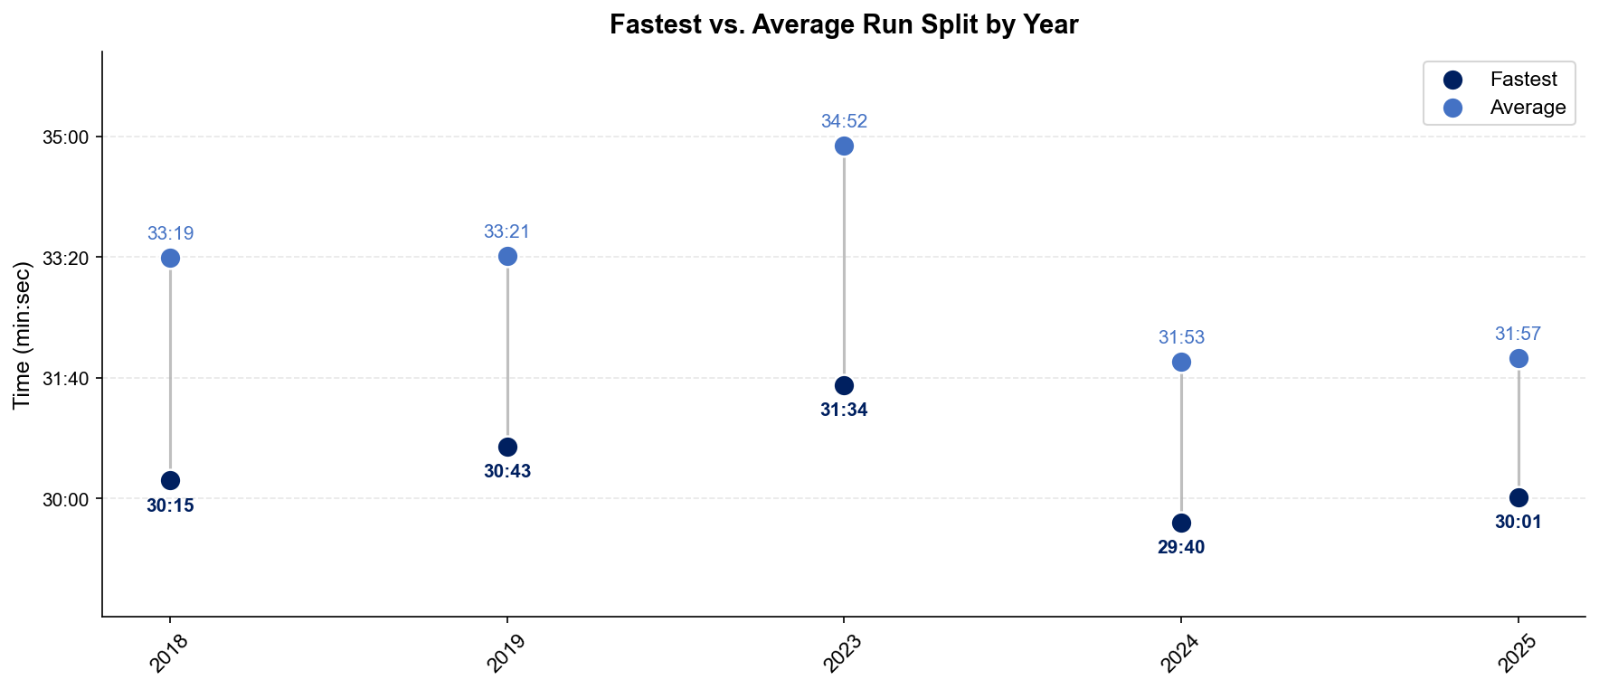
Run Split Analysis — Elite Men
Weihai

Slide 19
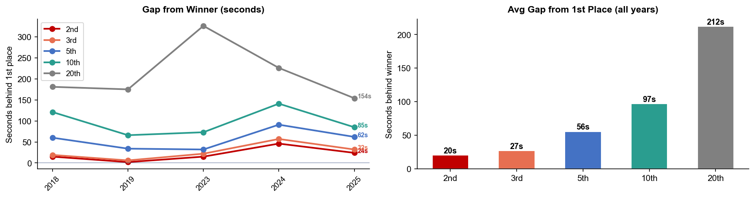
Key Position Times — Elite Men
Weihai
Year | 1st | 2nd | 3rd | 5th | 10th | 20th
2018 | 1:53:11 | 1:53:26 +15s | 1:53:30 +19s | 1:54:11 +60s | 1:55:12 +121s | 1:56:12 +181s
2019 | 1:54:47 | 1:54:49 +2s | 1:54:53 +6s | 1:55:21 +34s | 1:55:53 +66s | 1:57:42 +175s
2023 | 1:46:35 | 1:46:50 +15s | 1:46:57 +22s | 1:47:07 +32s | 1:47:48 +73s | 1:52:01 +326s
2024 | 1:48:21 | 1:49:07 +46s | 1:49:18 +57s | 1:49:52 +91s | 1:50:42 +141s | 1:52:07 +226s
2025 | 1:40:03 | 1:40:27 +24s | 1:40:35 +32s | 1:41:05 +62s | 1:41:28 +85s | 1:42:37 +154s

Slide 20
Race Conditions — Elite Men
Weihai
Year | Date | Air Temp | Humidity | Wind (km/h) | Precip (mm) | Water Temp | Wetsuit | Conditions
2018 | Sep 22 | 23.5°* | 39% | 9 | 0.0 | — | — | —
2019 | Sep 21 | 23.3°* | 66% | 20 | 0.0 | — | — | —
2023 | Aug 26 | 27.2 | 60% | 16 | 0.0 | 25.8 | forbidden | —
2024 | Sep 27 | 24.1 | 62% | 14 | 0.0 | 24.4 | forbidden | —
2025 | Sep 26 | 24.9 | 78% | 8 | 0.0 | 24.2 | forbidden | —
Air temp, humidity, wind, and precipitation sourced from Open-Meteo historical archive (race window 09:00–14:00 local) where WT API data is absent. Values marked * are Open-Meteo estimates. Water temp and wetsuit ruling are from the World Triathlon API per program.

Slide 21
ELITE WOMEN

Slide 22
Race Overview — Elite Women
Weihai
RACE HISTORY AT WEIHAI
3 KEYS TO SUCCESS
The Elite Women race at Weihai has been held 5 times in this analysis window (2018–2025). The event is staged as part of the World Cup / World Championship Series calendar. With a smaller field in the last two editions held at the WTCS level, the racing has tended to come together into T2 with the field then getting very spread out across the 10K. With warm temperatures anticipated here, its likely that a large group will race together on the bike, making it important to not overdo the opening 1-2K on the run.
1
The swim here has been important in separating the field into roughly two groups; however, a small breakaway has not been able to definitely breakaway in the last two WTCS editions here.
2
In the past two editions of the race, the bike has largely come together with the main group of ~20 athletes all together into T2 with only a field size of 28 athletes. The flat course here enables motivated chasers the opportunity to close small to mid deficits out of the water.
3
Field gets very separated on the run here, making it very important to stay true to one’s own red line pacing. With the top 10 separated by ~3 minutes, letting the field go out hard and come back in the back half of the race should be top of mind for younger athletes with less 10K experience.

Slide 23
Results Summary — Elite Women
Weihai
Year | Date | Category | Field | DNF/LAP/DNS | Winner | Winner Time | Air Temp | Water Temp | Swim km | Bike km | Run km
2018 | Sep 22 | World Cup | 44 | 9 | Spivey | 2:08:02 | 23.5°* | — | — | — | —
2019 | Sep 21 | World Cup | 32 | 5 | Derron | 2:08:03 | 23.3°* | — | — | — | —
2023 | Aug 26 | World Cup * | 34 | 7 | Seregni | 1:58:42 | 31.9 | 25.9 | 1.50 | 38.4 | 10.0
2024 | Sep 27 | World Championship Series * | 28 | 2 | Tertsch | 2:04:42 | 28 | 24.8 | 1.50 | 40.0 | 10.0
2025 | Sep 26 | World Championship Series * | 28 | 1 | Potter | 1:51:58 | 28.9 | 24.3 | 1.50 | 38.0 | 10.0
* Course distance changed vs. prior year

Slide 24
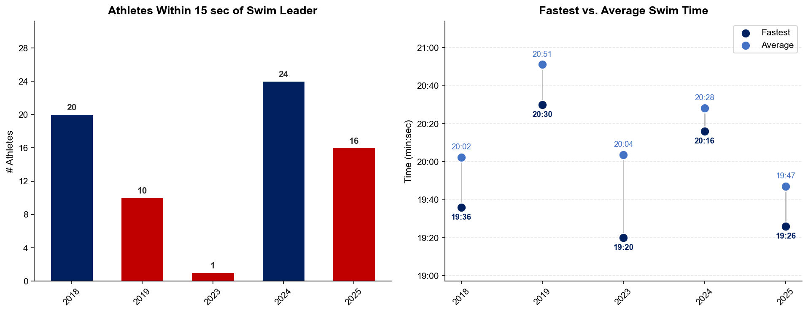
Swim Exit Dynamics — Elite Women
Weihai

Slide 25
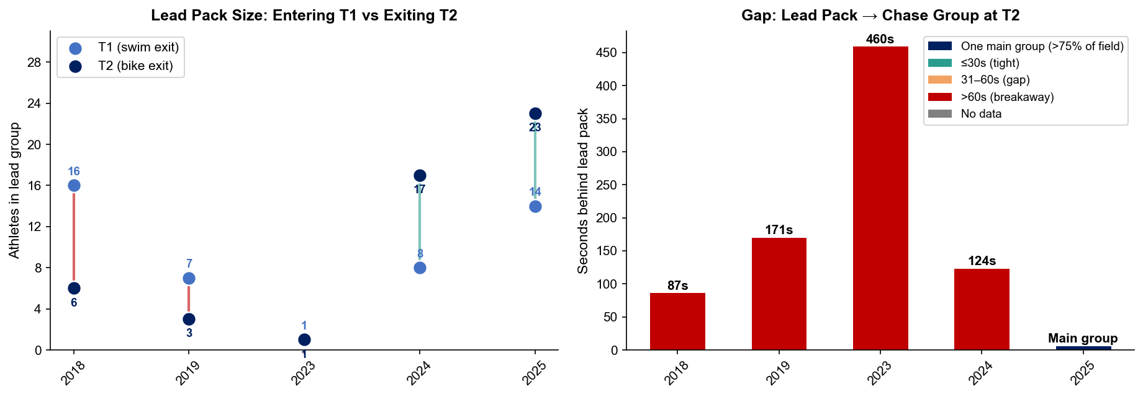
Bike Pack Evolution — Elite Women
Weihai
Lead pack = athletes within 15 sec of leader. T1 = lead group entering the bike; T2 = lead group exiting the bike.
Year | Lead Size @ T1 | Lead Size @ T2 | Change | Chase Group @ T2 | Chase Gap*
2018 | 16 | 6 | -10 | 1 | 87s
2019 | 7 | 3 | -4 | 8 | 171s
2023 | 1 | 1 | 0 | 14 | 460s
2024 | 8 | 17 | +9 | 1 | 124s
2025 | 14 | 23 | +9 | 4 | 204s
Lead pack = athletes within 15 sec of leader. Chase group = athletes within 15 sec of the first athlete outside the lead pack. * Chase Gap = seconds from the last lead-pack athlete to the first chase-group athlete at T2.
Dropouts: 2018: 9 DNF/LAP | 2019: 4 DNF/LAP | 2023: 7 DNF/LAP | 2024: 1 DNF/LAP | 2025: 1 DNF/LAP (1 in lead group at bike)

Slide 26
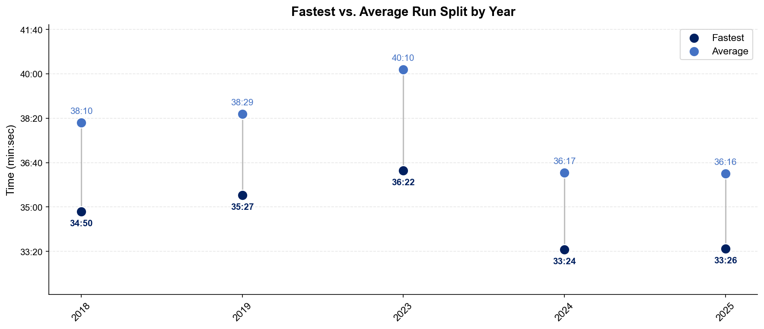
Run Split Analysis — Elite Women
Weihai

Slide 27
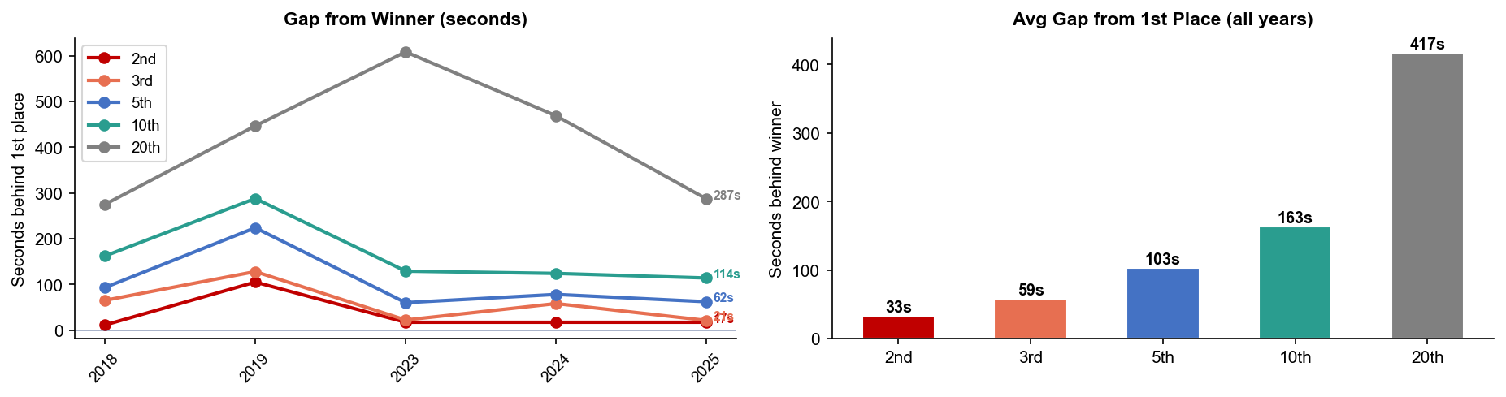
Key Position Times — Elite Women
Weihai
Year | 1st | 2nd | 3rd | 5th | 10th | 20th
2018 | 2:08:02 | 2:08:13 +11s | 2:09:07 +65s | 2:09:35 +93s | 2:10:44 +162s | 2:12:37 +275s
2019 | 2:08:03 | 2:09:48 +105s | 2:10:11 +128s | 2:11:47 +224s | 2:12:51 +288s | 2:15:30 +447s
2023 | 1:58:42 | 1:58:59 +17s | 1:59:04 +22s | 1:59:42 +60s | 2:00:51 +129s | 2:08:51 +609s
2024 | 2:04:42 | 2:04:59 +17s | 2:05:40 +58s | 2:06:00 +78s | 2:06:46 +124s | 2:12:31 +469s
2025 | 1:51:58 | 1:52:15 +17s | 1:52:19 +21s | 1:53:00 +62s | 1:53:52 +114s | 1:56:45 +287s

Slide 28
Race Conditions — Elite Women
Weihai
Year | Date | Air Temp | Humidity | Wind (km/h) | Precip (mm) | Water Temp | Wetsuit | Conditions
2018 | Sep 22 | 23.5°* | 39% | 9 | 0.0 | — | — | —
2019 | Sep 21 | 23.3°* | 66% | 20 | 0.0 | — | — | —
2023 | Aug 26 | 31.9 | 60% | 16 | 0.0 | 25.9 | forbidden | —
2024 | Sep 27 | 28 | 62% | 14 | 0.0 | 24.8 | forbidden | —
2025 | Sep 26 | 28.9 | 78% | 8 | 0.0 | 24.3 | forbidden | —
Air temp, humidity, wind, and precipitation sourced from Open-Meteo historical archive (race window 09:00–14:00 local) where WT API data is absent. Values marked * are Open-Meteo estimates. Water temp and wetsuit ruling are from the World Triathlon API per program.

